Slide 1















SCHOOL OF COMPUTING
Organizes
PROJECT TITLE
Write your company/idea name above and an intriguing summary of what your idea does here.
COMMUNITY PARTNERS :

Slide 2


Meet the Builders
THE TEAM
Team Member 1
Role / Title
LinkedIn · Email
Team Member 2
Role / Title
LinkedIn · Email
Team Member 3
Role / Title
LinkedIn · Email
Team Member 4
Role / Title
LinkedIn · Email
MENTOR
MENTOR
Mentor Name 1
Organization / Industry Expertise
Mentor Name 2
Organization / Industry Expertise

Slide 3

PROBLEM STATEMENT
01
The Problem
Define the specific problem you are addressing. What is the core challenge and pain point?
02
Why It Matters
Why is this problem important? Back it up with real-world data, statistics, or metrics if possible.
03
Who Is Affected?
Who is impacted by this issue? Identify your primary target users, communities, or institutions.

Slide 4
OUR APPROACH
01
The Idea
Your core idea, innovation, or product in one clear statement.
02
How It Works
How does it solve the problem — mechanism, workflow, or approach.
03
Show It Simply
A simple diagram or workflow that explains the solution at a glance.

Slide 5
Innovation & Differentiation
WHAT SETS US APART
Why Our Solution Stands Out
Discover what makes this solution unique and our core competitive advantages across technology, cost, access, and speed.
Uniqueness: Purpose-built to address critical friction points directly.
Advantage: Scalable tech architecture with a low barrier to entry.
Value: High-speed delivery with sustainable adoption cost.
US VS. THE REST
EXISTING SOLUTIONS
Manual & slow process
Limited accessibility
High cost of adoption
OUR SOLUTION
Automated & fast
Built for everyone
Low-cost & scalable

Slide 6
Market Potential & Impact
REACH & RELEVANCE
Why This Matters
Summarize the human or economic impact of solving this problem at scale — who benefits, and by how much.
Target Users
Who are your target users or customers? Define the primary and secondary audience.
Market Size
Estimated market size and reach — how big is the opportunity?
Expected Impact
Cost savings, accessibility, or better outcomes your solution unlocks.

Slide 7
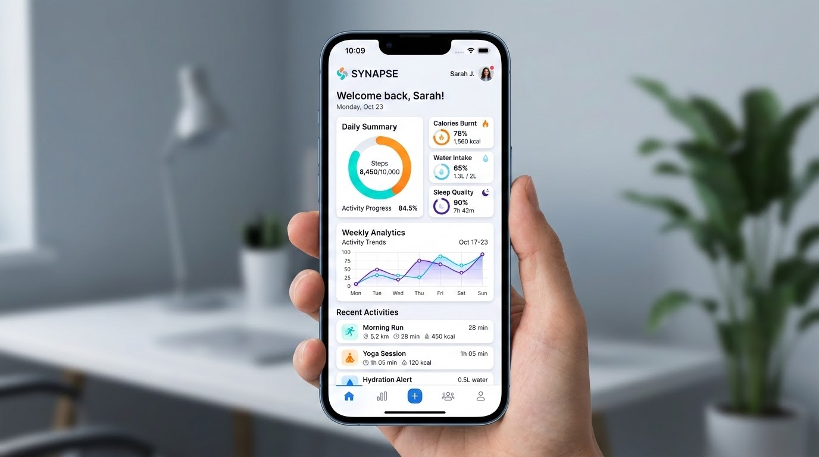
SEE IT IN ACTION
Key Features
Feature #1: Describe a core function or capability of your prototype.
Feature #2: Explain how this feature directly solves a user pain point.
Feature #3: Detail any unique technology, speed, or design advantages.
Feature #4: Highlight the user experience and ease of interaction.

Slide 8
Business & Sustainability Model
HOW THIS LIVES ON
Implementation
How will the solution be implemented and sustained beyond the hackathon? Describe your roll-out plan and scaling strategy.
Revenue Model
Any revenue model, funding path, or sustainability plan you have in mind to ensure long-term viability.
Partnerships
Partnerships or key stakeholders needed to bring this solution to life and amplify its ecosystem integration.

Slide 9
Market Sizing
SIZING THE OPPORTUNITY
Total Available Market
TAM
1.9B
The absolute total market demand for the product or service, representing the entire global opportunity.
Serviceable Available Market
SAM
53M
The specific segment of the total market that we can realistically target and serve with our business model.
Serviceable Obtainable Market
SOM
10.6M
Our short-term target within the next year—the share of the market we expect to realistically capture first.
FUNNEL LOGIC: TAM (the whole market) ➔ SAM (the segment you can realistically serve) ➔ SOM (what you can capture in year one).

Slide 10

Where We're Headed
ROADMAP & NEXT STEPS
01
STEP 1
Month 2026
Describe this milestone and what it unlocks for your product's development and scaling.
02
STEP 2
Month 2026
Describe this milestone and what it unlocks for your product's development and scaling.
03
STEP 3
Month 2026
Describe this milestone and what it unlocks for your product's development and scaling.
04
STEP 4
Month 2026
Describe this milestone and what it unlocks for your product's development and scaling.
VISION & MOMENTUM: A structured path designed to transform our hackathon prototype into a fully realized market solution.

Slide 11
Interactive Preview
PROTOTYPE & LIVE DEMO
Live Access
EXPLORE THE RUNNING SOLUTION
Scan the code or click the direct link below to launch the live interactive web demo built during HackFusion 2026.
(Paste the project link here)
Click above or enter in browser to view

Slide 12
THANK YOU
Have questions or want to collaborate? Let's build the future together.
EMAIL
SOCIAL
PHONE
team@email.com
Drop us a line anytime
@yourteam
Follow our updates
+91 00000 00000
Let's talk directly
HACKFUSION 2026: Thank you for your time and feedback. Let's build momentum.

